Slide 1


ACTIGNCE - (ACTIonable intelliGENCE)
By: Team – 4
Aneesh Antony Thomas
Amal Peediyakkal Shaji
Virat
Sreelekshmi Rajeshkumar
Neena Philip

Slide 2
Outline
Topics
Slide No.
Actignce Inroduction
Problem statement
Data source & Acquisition
Data preprocessing flowchart
RSI & SMA
Feature Extraction
Visualization
LSTM model
Training Model
Model Evaluation
Price prediction & Signaling
3
4
5
6
7-8
9
10-11
12
13
14
15

Slide 3
ACTIGNCE INTRODUCTION
1
Price prediction1
2
Signaling
1
in the stock market refers to the practice of forecasting the future price movements of a stock (or group of stocks) using various methods.
signals help people figure out whether they want to buy, sell, or hold a particular stock. However, no signal is foolproof—investors should still do their own research before making decisions.

Slide 4

Problem Statement
Investors/Traders are hesitant to participate in market due to fear of making wrong decisions.
Wrong decision leads to losses or less profit.

Slide 5
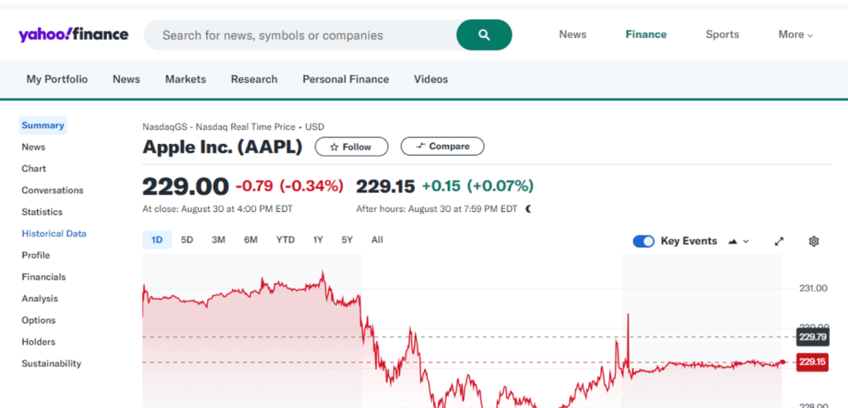
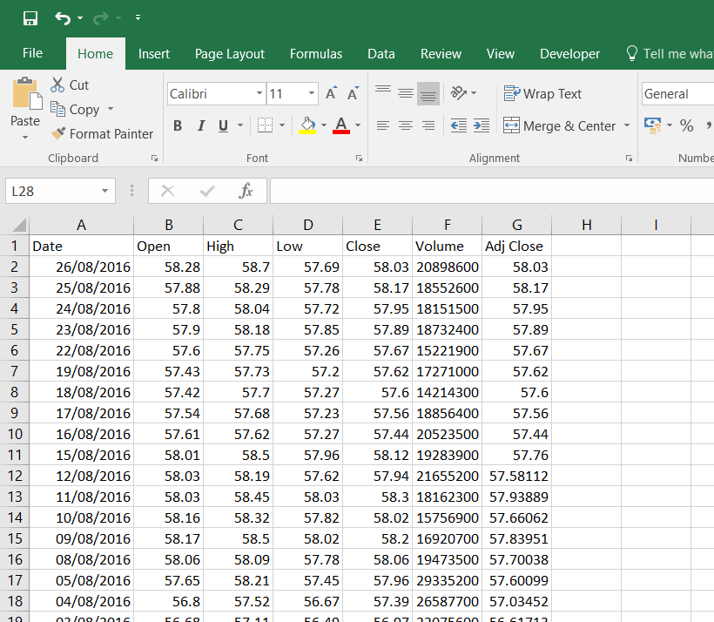
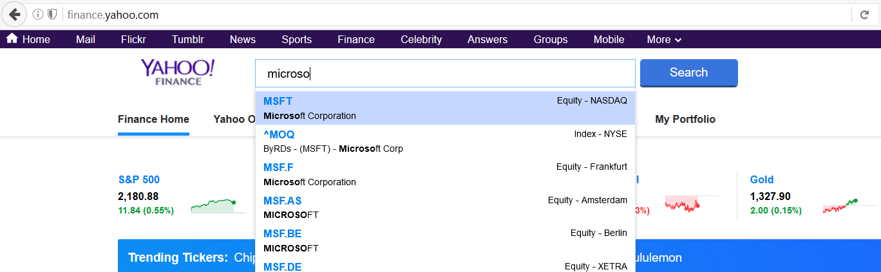

Data Source and Acquisition
Yahoo finance - real world data
Stock name
Dates
Opening and closing price
Day high and day low
Volume

Slide 6
Data preprocessing flowchart
Data Collection
Data Cleaning
Feature Engineering
Scaling
Sequence Building
Train-Test Split
Ready for model training

Slide 7
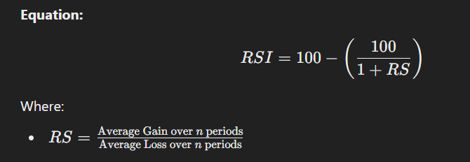
RSI (Relative Strength Index)
The Relative Strength Index (RSI) is a momentum oscillator that measures the speed and change of price movements. It oscillates between 0 and 100, helping identify overbought or oversold conditions.

Slide 8
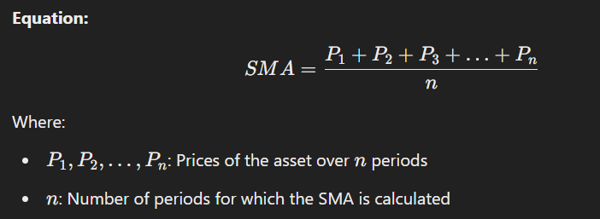
SMA(Simple Moving Average )
The Simple Moving Average (SMA) is a statistical measure that calculates the average of a set of prices over a specific number of periods. It smooths out price data to identify trends over time.

Slide 9
Feature Extraction
The process of transforming raw data into a set of meaningful, numerical attributes or features.
Input Dataset
Data Cleaning and Preprocessing
Feature Selection and Extraction
Model Training and Classification

Slide 10
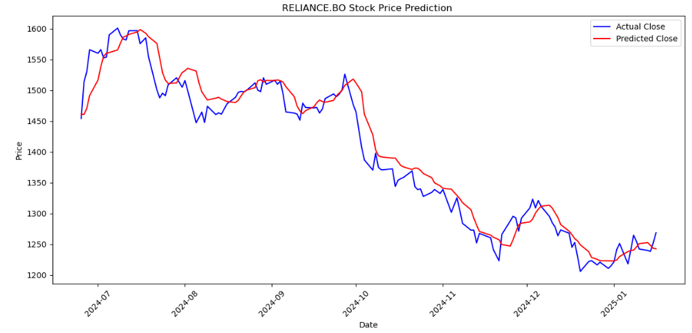
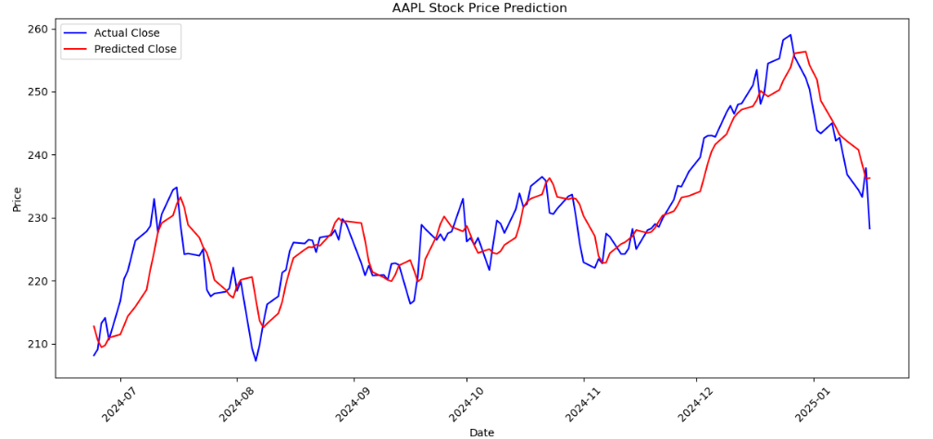
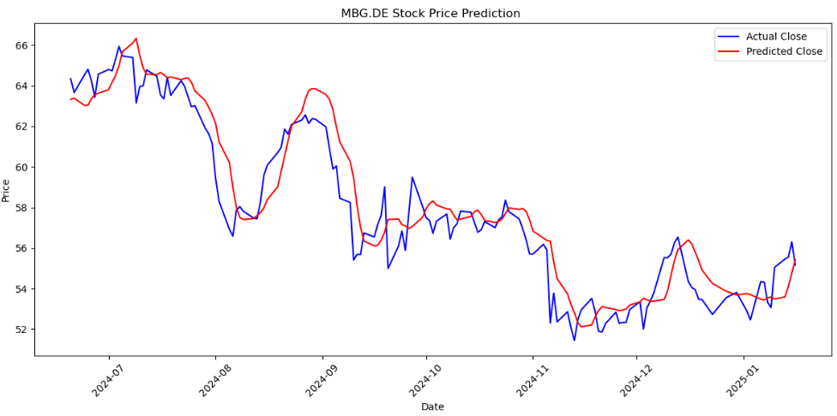
LSTM Model with name visualization of actual and predicted values
Reliance
Apple
Mercedes-Benz

Slide 11
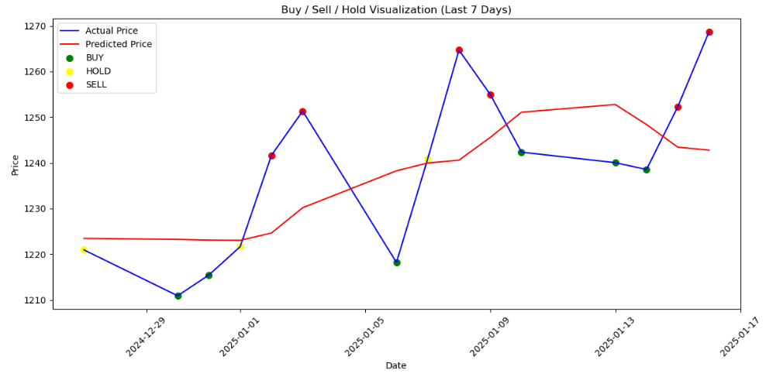
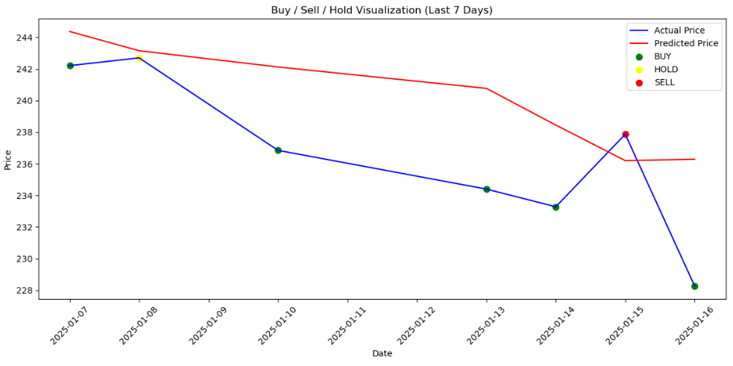
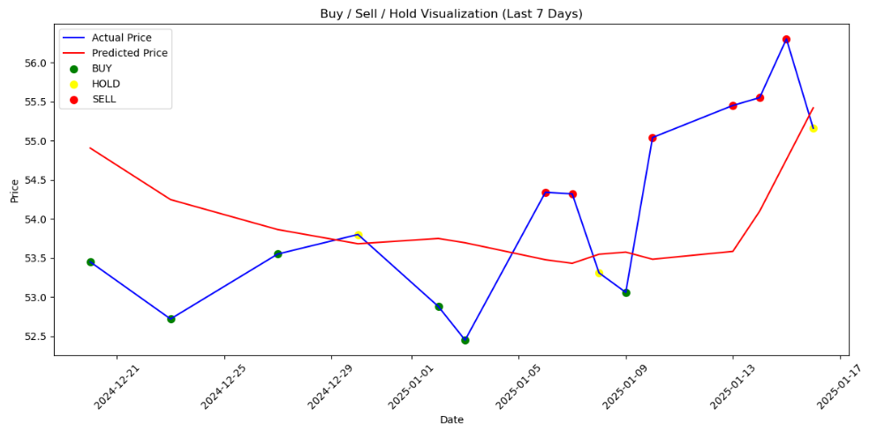
LSTM Model with name visualization of Buy,Sell,Hold values
Apple
Mercedes-Benz
Reliance

Slide 12
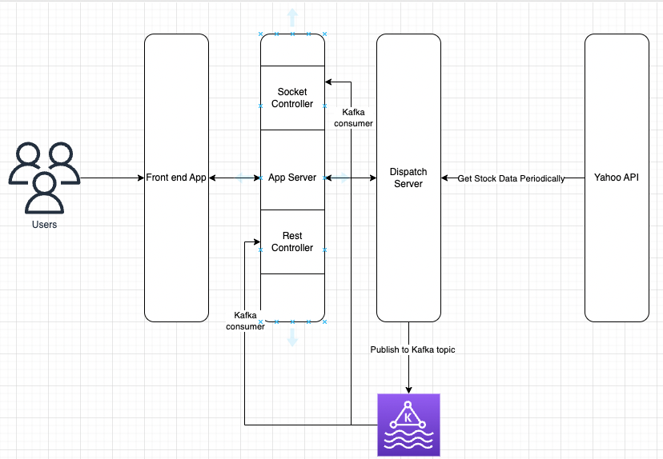
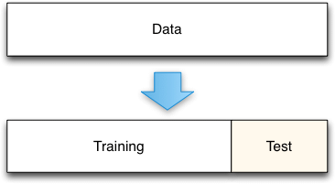
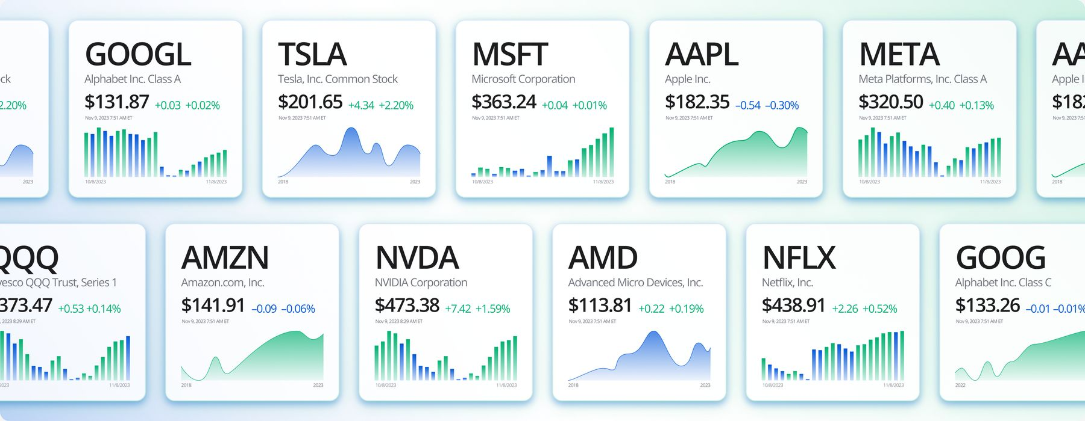
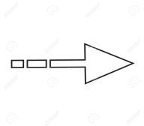


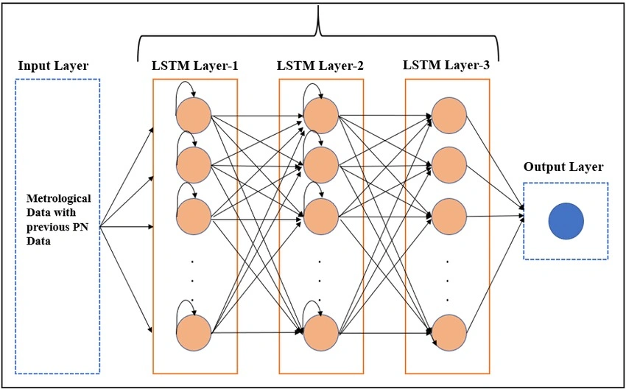
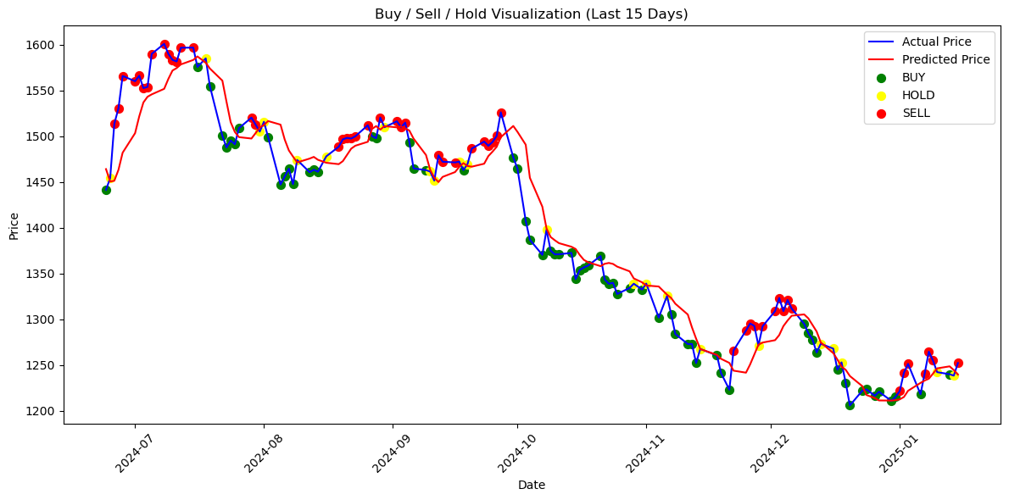
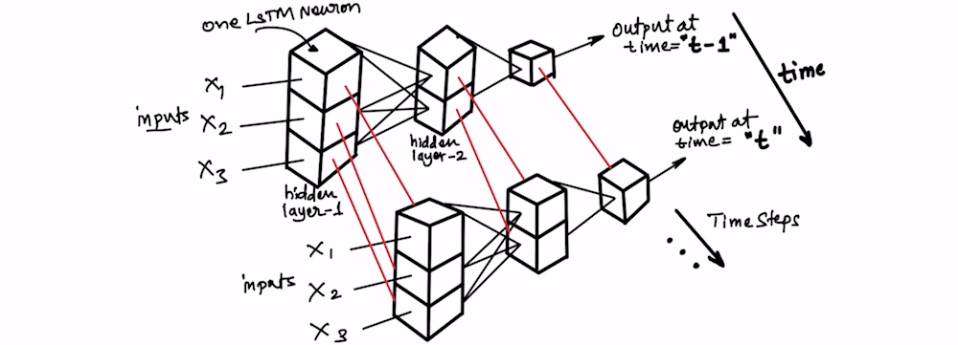
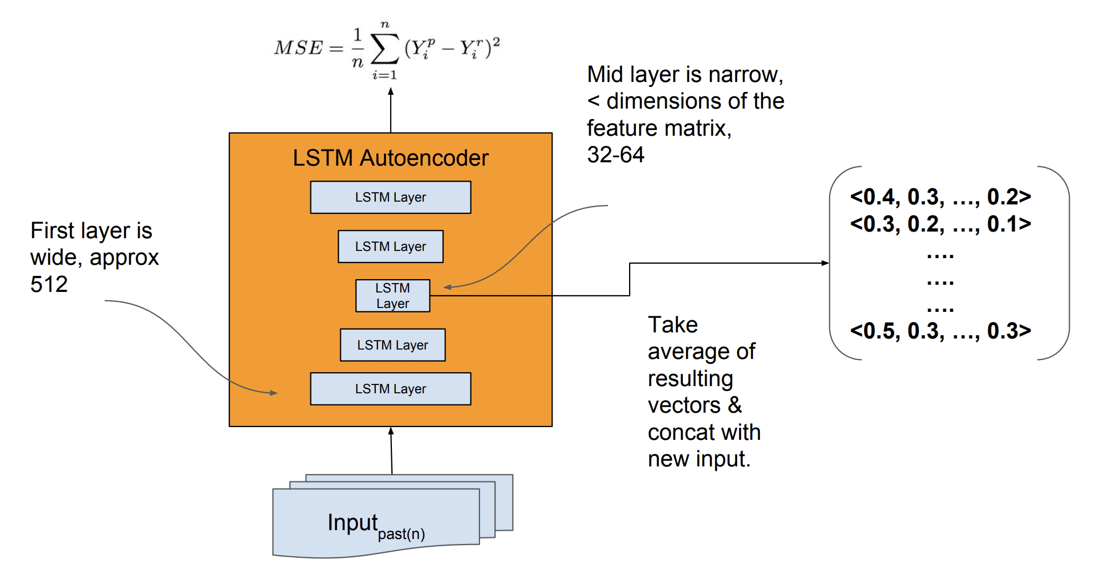
LSTM Model
Stock prices of past `n´ days from Yahoo Finance
Scaled Data
Training vs Testing Split
Actual vs Predicted Prices & Signals Overlay
Training Progress
Model Architecture

Slide 13
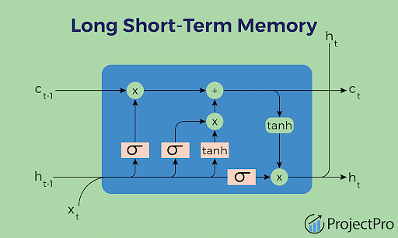
Training Model
LSTM (Long Short-Term Memory) is a type of neural network that works well with sequential data like stock prices . It uses memory cells and gates to retain important information over time, making it great for predicting future trends based on past data. LSTMs are widely used in tasks like stock market prediction. They require a lot of data and computational power to perform effectively.

Slide 14



Model Evaluation
We are using MSE & R² to evaluate performance of the model
Stock name : Reliance (RELIANCE:BO)
Stock name : Apple (AAPL)
Stock name : Mercedes-Benz (MBG:DE)

Slide 15
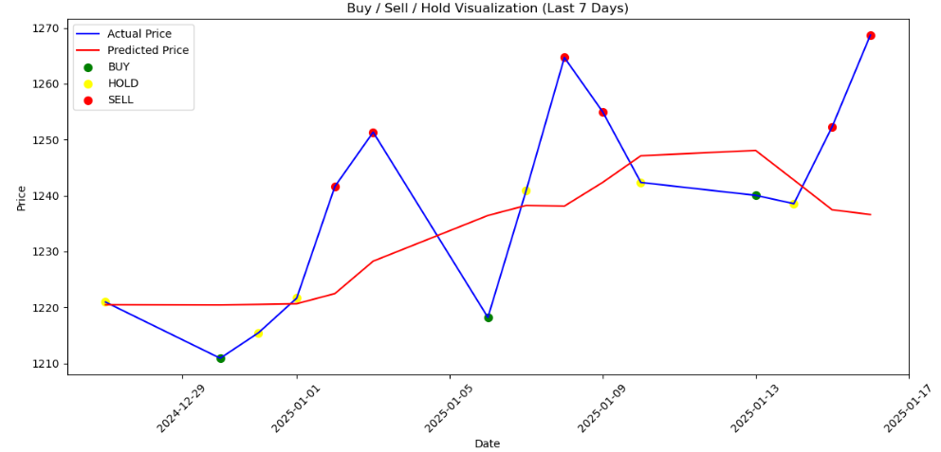
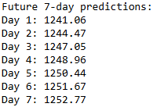
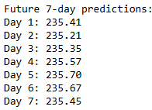
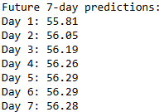
Price prediction & Signaling
Reliance
Apple
Mercedes-Benz

Slide 16
Thank You !
Thank You !

